Slide 1

CONFIGURACIÓN
RIPv1/RIPv2

Slide 2

CONFIGURACION BASICA
Configurar RIPv1:
►Activar el protocolo RIPv1:
router rip
►Anunciar redes:
network <dirección de red>
Configurar RIPv2 en R4
►Activar el protocolo RIPv2:
router rip
►Especificar la versión 2:
version 2
►Anunciar redes:
network <dirección de red>

Slide 3



EJEMPLO DE CONFIGURACIÓN RIPv2
200.1.1.64/26
PC2
.66
Fa2/0
Rb
Rc
.65
.2
Fa0/0
Fa1/0
.10
.5
40.1.2.4/30
.6
200.1.1.0/26
40.1.2.0/30
Fa1/0
.18
Fa0/0
40.1.2.8/30
200.1.1.128/26
Fa2/0
PC1
Ra
.1
Fa1/0
.9
Re
PC3
.1
Fa0/0
Fa2/0
.2
.13
40.1.2.16/30
.130
Fa2/0
.22
.129
Fa1/0
40.1.2.12/30
40.1.2.20/30
Fa0/0
Fa3/0
.17
.14
.21
Fa0/0
Fa1/0
Rd
.193
Fa2/0
.194
PC4
200.1.1.192/26

Slide 4
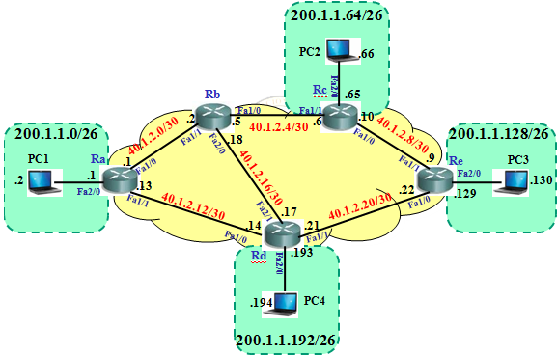
EJEMPLO DE CONFIGURACIÓN RIPv2
Tablas de enrutamiento inicial:
►Router Ra
Ra#show ip route
Codes: C - connected, S - static, R - RIP, M - mobile, B - BGP
D - EIGRP, EX - EIGRP external, O - OSPF, IA - OSPF inter area
N1 - OSPF NSSA external type 1, N2 - OSPF NSSA external type 2
E1 - OSPF external type 1, E2 - OSPF external type 2
i - IS-IS, su - IS-IS summary, L1 - IS-IS level-1, L2 - IS-IS level-2
ia - IS-IS inter area, * - candidate default, U - per-user static route
o - ODR, P - periodic downloaded static route
Gateway of last resort is not set
200.1.1.0/26 is subnetted, 1 subnets
C 200.1.1.0 is directly connected, FastEthernet2/0
40.0.0.0/30 is subnetted, 2 subnets
C 40.1.2.12 is directly connected, FastEthernet1/1
C 40.1.2.0 is directly connected, FastEthernet1/0
Ra#

Slide 5
EJEMPLO DE CONFIGURACIÓN RIPv2
Tablas de enrutamiento inicial:
►Router Rb
Rb#show ip route
Codes: C - connected, S - static, R - RIP, M - mobile, B - BGP
D - EIGRP, EX - EIGRP external, O - OSPF, IA - OSPF inter area
N1 - OSPF NSSA external type 1, N2 - OSPF NSSA external type 2
E1 - OSPF external type 1, E2 - OSPF external type 2
i - IS-IS, su - IS-IS summary, L1 - IS-IS level-1, L2 - IS-IS level-2
ia - IS-IS inter area, * - candidate default, U - per-user static route
o - ODR, P - periodic downloaded static route
Gateway of last resort is not set
40.0.0.0/30 is subnetted, 3 subnets
C 40.1.2.0 is directly connected, FastEthernet1/1
C 40.1.2.4 is directly connected, FastEthernet1/0
C 40.1.2.16 is directly connected, FastEthernet2/0
Rb#

Slide 6
EJEMPLO DE CONFIGURACIÓN RIPv2
Tablas de enrutamiento inicial:
►Router Rc
Rc#show ip route
Codes: C - connected, S - static, R - RIP, M - mobile, B - BGP
D - EIGRP, EX - EIGRP external, O - OSPF, IA - OSPF inter area
N1 - OSPF NSSA external type 1, N2 - OSPF NSSA external type 2
E1 - OSPF external type 1, E2 - OSPF external type 2
i - IS-IS, su - IS-IS summary, L1 - IS-IS level-1, L2 - IS-IS level-2
ia - IS-IS inter area, * - candidate default, U - per-user static route
o - ODR, P - periodic downloaded static route
Gateway of last resort is not set
200.1.1.0/26 is subnetted, 1 subnets
C 200.1.1.64 is directly connected, FastEthernet2/0
40.0.0.0/30 is subnetted, 2 subnets
C 40.1.2.8 is directly connected, FastEthernet1/0
C 40.1.2.4 is directly connected, FastEthernet1/1
Rc#

Slide 7
EJEMPLO DE CONFIGURACIÓN RIPv2
Tablas de enrutamiento inicial:
►Router Rd
Rd#show ip route
Codes: C - connected, S - static, R - RIP, M - mobile, B - BGP
D - EIGRP, EX - EIGRP external, O - OSPF, IA - OSPF inter area
N1 - OSPF NSSA external type 1, N2 - OSPF NSSA external type 2
E1 - OSPF external type 1, E2 - OSPF external type 2
i - IS-IS, su - IS-IS summary, L1 - IS-IS level-1, L2 - IS-IS level-2
ia - IS-IS inter area, * - candidate default, U - per-user static route
o - ODR, P - periodic downloaded static route
Gateway of last resort is not set
200.1.1.0/26 is subnetted, 1 subnets
C 200.1.1.192 is directly connected, FastEthernet2/0
40.0.0.0/30 is subnetted, 3 subnets
C 40.1.2.12 is directly connected, FastEthernet1/0
C 40.1.2.16 is directly connected, FastEthernet2/1
C 40.1.2.20 is directly connected, FastEthernet1/1
Rd#

Slide 8
EJEMPLO DE CONFIGURACIÓN RIPv2
Tablas de enrutamiento inicial:
►Router Re
Re#show ip route
Codes: C - connected, S - static, R - RIP, M - mobile, B - BGP
D - EIGRP, EX - EIGRP external, O - OSPF, IA - OSPF inter area
N1 - OSPF NSSA external type 1, N2 - OSPF NSSA external type 2
E1 - OSPF external type 1, E2 - OSPF external type 2
i - IS-IS, su - IS-IS summary, L1 - IS-IS level-1, L2 - IS-IS level-2
ia - IS-IS inter area, * - candidate default, U - per-user static route
o - ODR, P - periodic downloaded static route
Gateway of last resort is not set
200.1.1.0/26 is subnetted, 1 subnets
C 200.1.1.128 is directly connected, FastEthernet2/0
40.0.0.0/30 is subnetted, 2 subnets
C 40.1.2.8 is directly connected, FastEthernet1/1
C 40.1.2.20 is directly connected, FastEthernet1/0
Re#

Slide 9
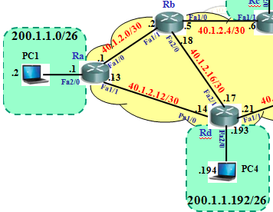
EJEMPLO DE CONFIGURACIÓN RIPv2
Configurando RIPv2: Routers Ra y Rb
Ra>
Ra>enable
Ra#configure terminal
Enter configuration commands, one per line. End with CNTL/Z.
Ra(config)#router rip
Ra(config-router)#version 2
Ra(config-router)#network 200.1.1.0
Ra(config-router)#network 40.0.0.0
Ra(config-router)#exit
Ra(config)#
Rb>
Rb>enable
Rb#configure terminal
Enter configuration commands, one per line. End with CNTL/Z.
Rb(config)#router rip
Rb(config-router)#version 2
Rb(config-router)#network 40.0.0.0
Rb(config-router)#exit
Rb(config)#

Slide 10
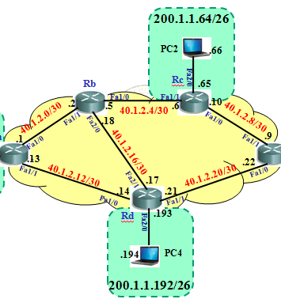
EJEMPLO DE CONFIGURACIÓN RIPv2
Configurando RIPv2: Routers Rc y Rd
Rc>
Rc>enable
Rc#configure terminal
Enter configuration commands, one per line. End with CNTL/Z.
Rc(config)#router rip
Rc(config-router)#version 2
Rc(config-router)#network 200.1.1.0
Rc(config-router)#network 40.0.0.0
Rc(config-router)#exit
Rc(config)#
Rd>
Rd>enable
Rd#configure terminal
Enter configuration commands, one per line. End with CNTL/Z.
Rd(config)#router rip
Rd(config-router)#version 2
Rd(config-router)#network 200.1.1.0
Rd(config-router)#network 40.0.0.0
Rd(config-router)#exit
Rd(config)#

Slide 11
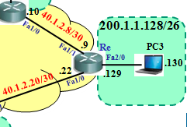
EJEMPLO DE CONFIGURACIÓN RIPv2
Configurando RIPv2: Router Re
Re>
Re>enable
Re#configure terminal
Enter configuration commands, one per line. End with CNTL/Z.
Re(config)#router rip
Re(config-router)#version 2
Re(config-router)#network 200.1.1.0
Re(config-router)#network 40.0.0.0
Re(config-router)#exit
Re(config)#

Slide 12
UN DETALLE: “SUMMARY”
Desde Ra como llega a 200.1.1.64/26
Ra# show ip route
Codes: C - connected, S - static, R - RIP, M - mobile, B - BGP
D - EIGRP, EX - EIGRP external, O - OSPF, IA - OSPF inter area
N1 - OSPF NSSA external type 1, N2 - OSPF NSSA external type 2
E1 - OSPF external type 1, E2 - OSPF external type 2
i - IS-IS, su - IS-IS summary, L1 - IS-IS level-1, L2 - IS-IS level-2
ia - IS-IS inter area, * - candidate default, U - per-user static route
o - ODR, P - periodic downloaded static route
Gateway of last resort is not set
200.1.1.0/24 is variably subnetted, 2 subnets, 2 masks
C 200.1.1.0/26 is directly connected, FastEthernet2/0
R 200.1.1.0/24 [120/1] via 40.1.2.14, 00:00:25, FastEthernet1/1
40.0.0.0/30 is subnetted, 6 subnets
R 40.1.2.8 [120/2] via 40.1.2.14, 00:00:25, FastEthernet1/1
[120/2] via 40.1.2.2, 00:00:11, FastEthernet1/0
C 40.1.2.12 is directly connected, FastEthernet1/1
C 40.1.2.0 is directly connected, FastEthernet1/0
R 40.1.2.4 [120/1] via 40.1.2.2, 00:00:11, FastEthernet1/0
R 40.1.2.16 [120/1] via 40.1.2.14, 00:00:25, FastEthernet1/1
[120/1] via 40.1.2.2, 00:00:11, FastEthernet1/0
R 40.1.2.20 [120/1] via 40.1.2.14, 00:00:25, FastEthernet1/1
Ra#
Salto siguiente 40.1.2.14
Aquí se ve a las redes
200.1.1.64, 200.1.1.128
y 200.1.1.192 como si
fuera la red 200.1.1.0
Ra#clear ip route *
Borra la tabla de enrutamiento.

Slide 13
UN DETALLE: “SUMMARY”
Desde Rd como llega a 200.1.1.0/26
Rd#show ip route
Codes: C - connected, S - static, R - RIP, M - mobile, B - BGP
D - EIGRP, EX - EIGRP external, O - OSPF, IA - OSPF inter area
N1 - OSPF NSSA external type 1, N2 - OSPF NSSA external type 2
E1 - OSPF external type 1, E2 - OSPF external type 2
i - IS-IS, su - IS-IS summary, L1 - IS-IS level-1, L2 - IS-IS level-2
ia - IS-IS inter area, * - candidate default, U - per-user static route
o - ODR, P - periodic downloaded static route
Gateway of last resort is not set
200.1.1.0/24 is variably subnetted, 2 subnets, 2 masks
C 200.1.1.192/26 is directly connected, FastEthernet2/0
R 200.1.1.0/24 [120/1] via 40.1.2.22, 00:00:05, FastEthernet1/1
[120/1] via 40.1.2.13, 00:00:10, FastEthernet1/0
40.0.0.0/30 is subnetted, 6 subnets
R 40.1.2.8 [120/1] via 40.1.2.22, 00:00:05, FastEthernet1/1
C 40.1.2.12 is directly connected, FastEthernet1/0
R 40.1.2.0 [120/1] via 40.1.2.18, 00:00:22, FastEthernet2/1
[120/1] via 40.1.2.13, 00:00:10, FastEthernet1/0
R 40.1.2.4 [120/1] via 40.1.2.18, 00:00:22, FastEthernet2/1
C 40.1.2.16 is directly connected, FastEthernet2/1
C 40.1.2.20 is directly connected, FastEthernet1/1
Rd#
Salto siguiente 40.1.2.13
Aquí se ve a las redes
200.1.1.0, 200.1.1.64,
y 200.1.1.128 como si
fuera la red 200.1.1.0
POSIBLE
BUCLE!!

Slide 14
SOLUCIÓN: DESACTIVAR “SUMMARY”
Ra>enable
Ra#configure terminal
Enter configuration commands, one per line. End with NTL/Z.
Ra(config)#router rip
Ra(config-router)#no auto-summary
Ra(config-router)#exit
Ra(config)#
Rd>enable
Rd#configure terminal
Enter configuration commands, one per line. End with NTL/Z.
Rd(config)#router rip
Rd(config-router)#no auto-summary
Rd(config-router)#exit
Rd(config)#
Rb>enable
Rb#configure terminal
Enter configuration commands, one per line. End with NTL/Z.
Rb(config)#router rip
Rb(config-router)#no auto-summary
Rb(config-router)#exit
Rb(config)#
Re>enable
Re#configure terminal
Enter configuration commands, one per line. End with NTL/Z.
Re(config)#router rip
Re(config-router)#no auto-summary
Re(config-router)#exit
Re(config)#
Rc>enable
Rc#configure terminal
Enter configuration commands, one per line. End with NTL/Z.
Rc(config)#router rip
Rc(config-router)#no auto-summary
Rc(config-router)#exit
Rc(config)#

Slide 15
ANALIZANDO NUEVAMENTE Ra”
Desde Ra como llega a 200.1.1.64/26
Ra#show ip route
Codes: C - connected, S - static, R - RIP, M - mobile, B - BGP
D - EIGRP, EX - EIGRP external, O - OSPF, IA - OSPF inter area
N1 - OSPF NSSA external type 1, N2 - OSPF NSSA external type 2
E1 - OSPF external type 1, E2 - OSPF external type 2
i - IS-IS, su - IS-IS summary, L1 - IS-IS level-1, L2 - IS-IS level-2
ia - IS-IS inter area, * - candidate default, U - per-user static route
o - ODR, P - periodic downloaded static route
Gateway of last resort is not set
200.1.1.0/24 is variably subnetted, 5 subnets, 2 masks
R 200.1.1.192/26 [120/1] via 40.1.2.14, 00:00:00, FastEthernet1/1
R 200.1.1.128/26 [120/2] via 40.1.2.14, 00:00:00, FastEthernet1/1
R 200.1.1.64/26 [120/2] via 40.1.2.2, 00:00:10, FastEthernet1/0
C 200.1.1.0/26 is directly connected, FastEthernet2/0
R 200.1.1.0/24 [120/2] via 40.1.2.14, 00:00:00, FastEthernet1/1
40.0.0.0/30 is subnetted, 6 subnets
R 40.1.2.8 [120/2] via 40.1.2.14, 00:00:00, FastEthernet1/1
[120/2] via 40.1.2.2, 00:00:10, FastEthernet1/0
C 40.1.2.12 is directly connected, FastEthernet1/1
C 40.1.2.0 is directly connected, FastEthernet1/0
R 40.1.2.4 [120/1] via 40.1.2.2, 00:00:10, FastEthernet1/0
R 40.1.2.16 [120/1] via 40.1.2.14, 00:00:00, FastEthernet1/1
[120/1] via 40.1.2.2, 00:00:10, FastEthernet1/0
R 40.1.2.20 [120/1] via 40.1.2.14, 00:00:06, FastEthernet1/1
Ra#
Aquí se ve a las redes
200.1.1.64, 200.1.1.128
y 200.1.1.192 de manera
independiente!!!!.

Slide 16
ANALIZANDO TABLAS DE ENRUTAMIENTO
Tabla de enrutamiento del Rb:
Rb# show ip route
Codes: C - connected, S - static, R - RIP, M - mobile, B - BGP
D - EIGRP, EX - EIGRP external, O - OSPF, IA - OSPF inter area
N1 - OSPF NSSA external type 1, N2 - OSPF NSSA external type 2
E1 - OSPF external type 1, E2 - OSPF external type 2
i - IS-IS, su - IS-IS summary, L1 - IS-IS level-1, L2 - IS-IS level-2
ia - IS-IS inter area, * - candidate default, U - per-user static route
o - ODR, P - periodic downloaded static route
Gateway of last resort is not set
200.1.1.0/26 is subnetted, 4 subnets
R 200.1.1.192 [120/1] via 40.1.2.17, 00:00:14, FastEthernet2/0
R 200.1.1.128 [120/2] via 40.1.2.17, 00:00:14, FastEthernet2/0
[120/2] via 40.1.2.6, 00:00:10, FastEthernet1/0
R 200.1.1.64 [120/1] via 40.1.2.6, 00:00:10, FastEthernet1/0
R 200.1.1.0 [120/1] via 40.1.2.1, 00:00:12, FastEthernet1/1
40.0.0.0/30 is subnetted, 6 subnets
R 40.1.2.8 [120/1] via 40.1.2.6, 00:00:10, FastEthernet1/0
R 40.1.2.12 [120/1] via 40.1.2.17, 00:00:14, FastEthernet2/0
[120/1] via 40.1.2.1, 00:00:12, FastEthernet1/1
C 40.1.2.0 is directly connected, FastEthernet1/1
C 40.1.2.4 is directly connected, FastEthernet1/0
C 40.1.2.16 is directly connected, FastEthernet2/0
R 40.1.2.20 [120/1] via 40.1.2.17, 00:00:17, FastEthernet2/0
Rb#
La redes LAN están
detalladas.
Se observa el balanceo de
carga hacia: 200.1.1.128

Slide 17
ANALIZANDO TABLAS DE ENRUTAMIENTO
Tabla de enrutamiento del Rc:
Rc#show ip route
Codes: C - connected, S - static, R - RIP, M - mobile, B - BGP
D - EIGRP, EX - EIGRP external, O - OSPF, IA - OSPF inter area
N1 - OSPF NSSA external type 1, N2 - OSPF NSSA external type 2
E1 - OSPF external type 1, E2 - OSPF external type 2
i - IS-IS, su - IS-IS summary, L1 - IS-IS level-1, L2 - IS-IS level-2
ia - IS-IS inter area, * - candidate default, U - per-user static route
o - ODR, P - periodic downloaded static route
Gateway of last resort is not set
200.1.1.0/26 is subnetted, 4 subnets
R 200.1.1.192 [120/2] via 40.1.2.9, 00:00:12, FastEthernet1/0
[120/2] via 40.1.2.5, 00:00:24, FastEthernet1/1
R 200.1.1.128 [120/1] via 40.1.2.9, 00:00:12, FastEthernet1/0
C 200.1.1.64 is directly connected, FastEthernet2/0
R 200.1.1.0 [120/2] via 40.1.2.5, 00:00:24, FastEthernet1/1
40.0.0.0/30 is subnetted, 6 subnets
C 40.1.2.8 is directly connected, FastEthernet1/0
R 40.1.2.12 [120/2] via 40.1.2.9, 00:00:12, FastEthernet1/0
[120/2] via 40.1.2.5, 00:00:24, FastEthernet1/1
R 40.1.2.0 [120/1] via 40.1.2.5, 00:00:24, FastEthernet1/1
C 40.1.2.4 is directly connected, FastEthernet1/1
R 40.1.2.16 [120/1] via 40.1.2.5, 00:00:24, FastEthernet1/1
R 40.1.2.20 [120/1] via 40.1.2.9, 00:00:13, FastEthernet1/0
Rc#
La redes LAN están
detalladas.
Se observa el balanceo de
carga hacia: 200.1.1.192

Slide 18
ANALIZANDO TABLAS DE ENRUTAMIENTO
Tabla de enrutamiento del Rd:
Rd#show ip route
Codes: C - connected, S - static, R - RIP, M - mobile, B - BGP
D - EIGRP, EX - EIGRP external, O - OSPF, IA - OSPF inter area
N1 - OSPF NSSA external type 1, N2 - OSPF NSSA external type 2
E1 - OSPF external type 1, E2 - OSPF external type 2
i - IS-IS, su - IS-IS summary, L1 - IS-IS level-1, L2 - IS-IS level-2
ia - IS-IS inter area, * - candidate default, U - per-user static route
o - ODR, P - periodic downloaded static route
Gateway of last resort is not set
200.1.1.0/26 is subnetted, 4 subnets
C 200.1.1.192 is directly connected, FastEthernet2/0
R 200.1.1.128 [120/1] via 40.1.2.22, 00:00:00, FastEthernet1/1
R 200.1.1.64 [120/2] via 40.1.2.22, 00:00:00, FastEthernet1/1
[120/2] via 40.1.2.18, 00:00:00, FastEthernet2/1
R 200.1.1.0 [120/1] via 40.1.2.13, 00:00:24, FastEthernet1/0
40.0.0.0/30 is subnetted, 6 subnets
R 40.1.2.8 [120/1] via 40.1.2.22, 00:00:00, FastEthernet1/1
C 40.1.2.12 is directly connected, FastEthernet1/0
R 40.1.2.0 [120/1] via 40.1.2.18, 00:00:00, FastEthernet2/1
[120/1] via 40.1.2.13, 00:00:24, FastEthernet1/0
R 40.1.2.4 [120/1] via 40.1.2.18, 00:00:00, FastEthernet2/1
C 40.1.2.16 is directly connected, FastEthernet2/1
C 40.1.2.20 is directly connected, FastEthernet1/1
Rd#
La redes LAN están
detalladas.
Se observa el balanceo de
carga hacia: 200.1.1.64

Slide 19
ANALIZANDO TABLAS DE ENRUTAMIENTO
Tabla de enrutamiento del Re:
Re#show ip route
Codes: C - connected, S - static, R - RIP, M - mobile, B - BGP
D - EIGRP, EX - EIGRP external, O - OSPF, IA - OSPF inter area
N1 - OSPF NSSA external type 1, N2 - OSPF NSSA external type 2
E1 - OSPF external type 1, E2 - OSPF external type 2
i - IS-IS, su - IS-IS summary, L1 - IS-IS level-1, L2 - IS-IS level-2
ia - IS-IS inter area, * - candidate default, U - per-user static route
o - ODR, P - periodic downloaded static route
Gateway of last resort is not set
200.1.1.0/26 is subnetted, 4 subnets
R 200.1.1.192 [120/1] via 40.1.2.21, 00:00:22, FastEthernet1/0
C 200.1.1.128 is directly connected, FastEthernet2/0
R 200.1.1.64 [120/1] via 40.1.2.10, 00:00:27, FastEthernet1/1
R 200.1.1.0 [120/2] via 40.1.2.21, 00:00:22, FastEthernet1/0
40.0.0.0/30 is subnetted, 6 subnets
C 40.1.2.8 is directly connected, FastEthernet1/1
R 40.1.2.12 [120/1] via 40.1.2.21, 00:00:22, FastEthernet1/0
R 40.1.2.0 [120/2] via 40.1.2.21, 00:00:22, FastEthernet1/0
[120/2] via 40.1.2.10, 00:00:27, FastEthernet1/1
R 40.1.2.4 [120/1] via 40.1.2.10, 00:00:27, FastEthernet1/1
R 40.1.2.16 [120/1] via 40.1.2.21, 00:00:22, FastEthernet1/0
C 40.1.2.20 is directly connected, FastEthernet1/0
Re#
La redes LAN están
detalladas.

Slide 20
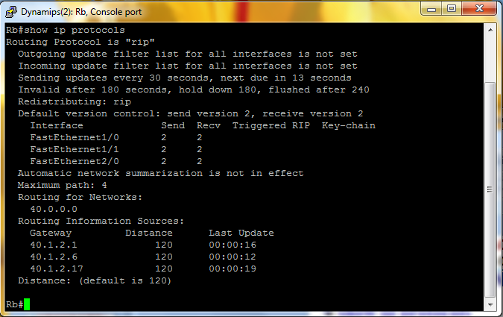
COMANDOS DE ANÁLISIS DE RED CON RIP
show ip protocols
►Muestra el protocolo de
enrutamiento configurado.
►Si es RIP, permite
ver la mayoría de
sus parámetros
(temporizadores,
etc).
Auto resumen desactivado

Slide 21

INTERFAZ PASIVA
Envío
actualizaciones?
Se debe anunciar la red
200.1.1.0 donde está el
servidor, para que sea
accedido externamente.
Servidor
200.1.1.4/24
Fa0/0
.1
S0/0
.221
R1
S0/1
.42
20.3.3.40/30
S0/0
.41
No se debe enviar al servidor
actualizaciones. Para que??
22.2.2.220/30
R3
S0/1
.62
30.4.4.60/30
R1(config)#
router rip
S0/0
.61
R1(config-router)#
version 2
S0/1
.222
R2
R1(config-router)#
network 200.1.1.0
R1(config-router)#
network 22.2.2.220
R1(config-router)#
network 20.3.3.40
R1(config-router)#
passive-interface fastethernet 0/0
R1(config-router)#
exit
R1#debug ip rip ; permite ver actualizaciones según se genere.
R1(config)#

Slide 22
PROPAGACIÓN DE RUTA POR DEFECTO
200.2.2.0/24
R1
R2
50.5.5.0/30
.9
PC1
.2
.1
.1
.2
50.5.8.0/30
60.6.6.0/30
210.10.10.0/24
.10
.1
.2
.1
.2
PC2
.13
50.5.12.0/30
R5
R6
PC3
.2
.1
.5
.6
.14
200.2.3.0/24
R3
50.5.5.4/30
R4
R5#show ip route
50.0.0.0/30 is subnetted, 4 subnets
R 50.5.5.0 [120/1] via 50.5.5.9, 00:00:01, FastEthernet0/1
R 50.5.5.4 [120/1] via 50.5.5.14, 00:00:24, FastEthernet0/0
C 50.5.5.8 is directly connected, FastEthernet0/1
C 50.5.5.12 is directly connected, FastEthernet0/0
R 210.10.10.0/24 [120/1] via 60.6.6.2, 00:00:08, FastEthernet1/0
R 200.2.2.0/24 [120/2] via 50.5.5.9, 00:00:01, FastEthernet0/1
R 200.2.3.0/24 [120/2] via 50.5.5.14, 00:00:24, FastEthernet0/0
60.0.0.0/30 is subnetted, 1 subnets
C 60.6.6.0 is directly connected, FastEthernet1/0
R5#
R4#show ip route
50.0.0.0/30 is subnetted, 4 subnets
R 50.5.5.0 [120/2] via 50.5.5.13, 00:00:22, FastEthernet0/1
C 50.5.5.4 is directly connected, FastEthernet0/0
R 50.5.5.8 [120/1] via 50.5.5.13, 00:00:22, FastEthernet0/1
C 50.5.5.12 is directly connected, FastEthernet0/1
R 210.10.10.0/24 [120/2] via 50.5.5.13, 00:00:22, FastEthernet0/1
R 200.2.2.0/24 [120/3] via 50.5.5.13, 00:00:22, FastEthernet0/1
R 200.2.3.0/24 [120/1] via 50.5.5.5, 00:00:17, FastEthernet0/0
R 60.0.0.0/8 [120/1] via 50.5.5.13, 00:00:22, FastEthernet0/1
R4#
R3#show ip route
50.0.0.0/30 is subnetted, 4 subnets
R 50.5.5.0 [120/3] via 50.5.5.6, 00:00:09, FastEthernet0/1
C 50.5.5.4 is directly connected, FastEthernet0/1
R 50.5.5.8 [120/2] via 50.5.5.6, 00:00:09, FastEthernet0/1
R 50.5.5.12 [120/1] via 50.5.5.6, 00:00:09, FastEthernet0/1
R 210.10.10.0/24 [120/3] via 50.5.5.6, 00:00:09, FastEthernet0/1
R 200.2.2.0/24 [120/4] via 50.5.5.6, 00:00:09, FastEthernet0/1
C 200.2.3.0/24 is directly connected, FastEthernet0/0
R 60.0.0.0/8 [120/2] via 50.5.5.6, 00:00:09, FastEthernet0/1
R3#
R2#show ip route
50.0.0.0/30 is subnetted, 4 subnets
C 50.5.5.0 is directly connected, FastEthernet0/0
R 50.5.5.4 [120/2] via 50.5.5.10, 00:00:06, FastEthernet0/1
C 50.5.5.8 is directly connected, FastEthernet0/1
R 50.5.5.12 [120/1] via 50.5.5.10, 00:00:06, FastEthernet0/1
R 210.10.10.0/24 [120/2] via 50.5.5.10, 00:00:06, FastEthernet0/1
R 200.2.2.0/24 [120/1] via 50.5.5.1, 00:00:14, FastEthernet0/0
R 200.2.3.0/24 [120/3] via 50.5.5.10, 00:00:06, FastEthernet0/1
R 60.0.0.0/8 [120/1] via 50.5.5.10, 00:00:06, FastEthernet0/1
R2#
R1#show ip route
50.0.0.0/30 is subnetted, 4 subnets
C 50.5.5.0 is directly connected, FastEthernet0/1
R 50.5.5.4 [120/3] via 50.5.5.2, 00:00:11, FastEthernet0/1
R 50.5.5.8 [120/1] via 50.5.5.2, 00:00:11, FastEthernet0/1
R 50.5.5.12 [120/2] via 50.5.5.2, 00:00:11, FastEthernet0/1
R 210.10.10.0/24 [120/3] via 50.5.5.2, 00:00:11, FastEthernet0/1
C 200.2.2.0/24 is directly connected, FastEthernet0/0
R 200.2.3.0/24 [120/4] via 50.5.5.2, 00:00:11, FastEthernet0/1
R 60.0.0.0/8 [120/2] via 50.5.5.2, 00:00:11, FastEthernet0/1
R1#

Slide 23
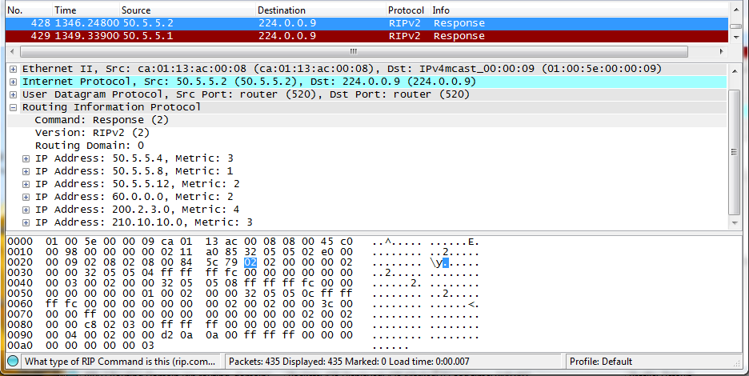
PROPAGACIÓN DE RUTA POR DEFECTO
200.2.2.0/24
R1
R2
50.5.5.0/30
.9
PC1
.2
.1
.1
.2
50.5.8.0/30
RIP
60.6.6.0/30
210.10.10.0/24
.10
.1
.2
.1
.2
PC2
.13
50.5.12.0/30
R5
R6
PC3
.2
.1
.5
.6
.14
200.2.3.0/24
R3
50.5.5.4/30
R4
Redes
anunciadas

Slide 24
PROPAGACIÓN DE RUTA POR DEFECTO
default-information originate
►Permite que el router propague la ruta estática por defecto, en las
actualizaciones RIP.
200.2.2.0/24
R1
R2
50.5.5.0/30
.9
.2
.1
.1
.2
50.5.8.0/30
210.10.10.0/24
PC1
.10
60.6.6.0/30
.1
.2
.1
.2
.13
50.5.12.0/30
R5
R6
PC3
.2
.1
.5
.6
.14
200.2.3.0/24
R3
50.5.5.4/30
R4
PC2
R5#configure terminal
R5(config)#router rip
R5(config-router)#default-information originate

Slide 25
PROPAGACIÓN DE RUTA POR DEFECTO
200.2.2.0/24
R1
R2
50.5.5.0/30
.9
PC1
.2
.1
.1
.2
50.5.8.0/30
60.6.6.0/30
210.10.10.0/24
.10
.1
.2
.1
.2
PC2
.13
50.5.12.0/30
R5
R6
PC3
.2
.1
.5
.6
Desde RI, R2, R3, R4 y R6 se podrá ir a cualquier
red, debido que sus tablas tiene la red 0.0.0.0
.14
200.2.3.0/24
R3
50.5.5.4/30
R4
R2#show ip route
50.0.0.0/30 is subnetted, 4 subnets
C 50.5.5.0 is directly connected, FastEthernet0/0
R 50.5.5.4 [120/2] via 50.5.5.10, 00:00:05, FastEthernet0/1
C 50.5.5.8 is directly connected, FastEthernet0/1
R 50.5.5.12 [120/1] via 50.5.5.10, 00:00:05, FastEthernet0/1
R 210.10.10.0/24 [120/2] via 50.5.5.10, 00:00:05, FastEthernet0/1
R 200.2.2.0/24 [120/1] via 50.5.5.1, 00:00:04, FastEthernet0/0
R 200.2.3.0/24 [120/3] via 50.5.5.10, 00:00:05, FastEthernet0/1
R 60.0.0.0/8 [120/1] via 50.5.5.10, 00:00:05, FastEthernet0/1
R* 0.0.0.0/0 [120/1] via 50.5.5.10, 00:00:05, FastEthernet0/1
R2#
R1#show ip route
50.0.0.0/30 is subnetted, 4 subnets
C 50.5.5.0 is directly connected, FastEthernet0/1
R 50.5.5.4 [120/3] via 50.5.5.2, 00:00:24, FastEthernet0/1
R 50.5.5.8 [120/1] via 50.5.5.2, 00:00:24, FastEthernet0/1
R 50.5.5.12 [120/2] via 50.5.5.2, 00:00:24, FastEthernet0/1
R 210.10.10.0/24 [120/3] via 50.5.5.2, 00:00:24, FastEthernet0/1
C 200.2.2.0/24 is directly connected, FastEthernet0/0
R 200.2.3.0/24 [120/4] via 50.5.5.2, 00:00:24, FastEthernet0/1
R 60.0.0.0/8 [120/2] via 50.5.5.2, 00:00:24, FastEthernet0/1
R* 0.0.0.0/0 [120/2] via 50.5.5.2, 00:00:24, FastEthernet0/1
R1#
R4#show ip route
50.0.0.0/30 is subnetted, 4 subnets
R 50.5.5.0 [120/2] via 50.5.5.13, 00:00:02, FastEthernet0/1
C 50.5.5.4 is directly connected, FastEthernet0/0
R 50.5.5.8 [120/1] via 50.5.5.13, 00:00:02, FastEthernet0/1
C 50.5.5.12 is directly connected, FastEthernet0/1
R 210.10.10.0/24 [120/2] via 50.5.5.13, 00:00:02, FastEthernet0/1
R 200.2.2.0/24 [120/3] via 50.5.5.13, 00:00:02, FastEthernet0/1
R 200.2.3.0/24 [120/1] via 50.5.5.5, 00:00:02, FastEthernet0/0
R 60.0.0.0/8 [120/1] via 50.5.5.13, 00:00:02, FastEthernet0/1
R* 0.0.0.0/0 [120/1] via 50.5.5.13, 00:00:02, FastEthernet0/1
R4#
R3#show ip route
50.0.0.0/30 is subnetted, 4 subnets
R 50.5.5.0 [120/3] via 50.5.5.6, 00:00:00, FastEthernet0/1
C 50.5.5.4 is directly connected, FastEthernet0/1
R 50.5.5.8 [120/2] via 50.5.5.6, 00:00:00, FastEthernet0/1
R 50.5.5.12 [120/1] via 50.5.5.6, 00:00:00, FastEthernet0/1
R 210.10.10.0/24 [120/3] via 50.5.5.6, 00:00:00, FastEthernet0/1
R 200.2.2.0/24 [120/4] via 50.5.5.6, 00:00:00, FastEthernet0/1
C 200.2.3.0/24 is directly connected, FastEthernet0/0
R 60.0.0.0/8 [120/2] via 50.5.5.6, 00:00:00, FastEthernet0/1
R* 0.0.0.0/0 [120/2] via 50.5.5.6, 00:00:00, FastEthernet0/1
R3#
R6#show ip route
R 50.0.0.0/8 [120/1] via 60.6.6.1, 00:00:04, FastEthernet0/1
C 210.10.10.0/24 is directly connected, FastEthernet0/0
R 200.2.2.0/24 [120/3] via 60.6.6.1, 00:00:04, FastEthernet0/1
R 200.2.3.0/24 [120/3] via 60.6.6.1, 00:00:04, FastEthernet0/1
60.0.0.0/30 is subnetted, 1 subnets
C 60.6.6.0 is directly connected, FastEthernet0/1
R* 0.0.0.0/0 [120/1] via 60.6.6.1, 00:00:04, FastEthernet0/1
R6#
Observar que R5 falta adicionar: no- auto-summary De allí que aparezca en R1, R2, R3 y R4: 60.0.0.0/8

Slide 26
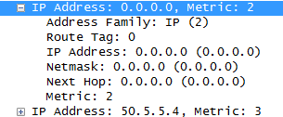
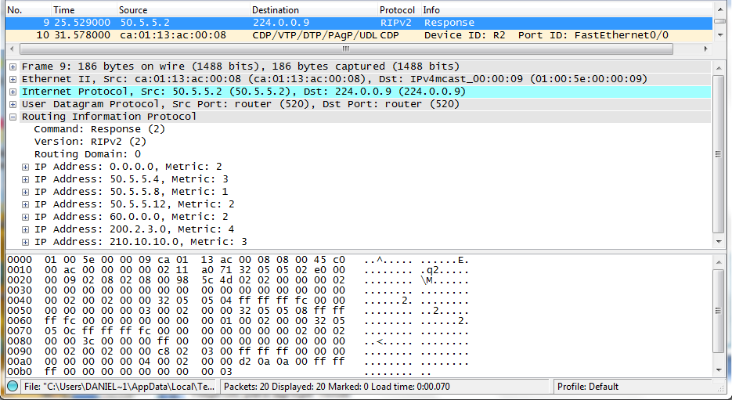
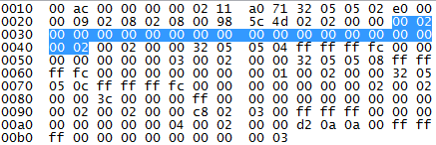
PROPAGACIÓN DE RUTA POR DEFECTO
200.2.2.0/24
R1
R2
50.5.5.0/30
.9
PC1
.2
.1
.1
.2
50.5.8.0/30
RIP
60.6.6.0/30
210.10.10.0/24
.10
.1
.2
.1
.2
.13
PC2
50.5.12.0/30
R5
R6
PC3
.2
.1
.5
.6
.14
200.2.3.0/24
R3
50.5.5.4/30
R4
Ruta por
defecto
Redes
anunciadas

Slide 27
PROPAGACIÓN DE RUTA POR DEFECTO
200.2.2.0/24
R1
R2
Habilitado con RIPv2
50.5.5.0/30
.9
PC1
.2
.1
.1
.2
50.5.8.0/30
60.6.6.0/30
210.10.10.0/24
.10
.1
.2
.1
.2
PC2
.13
50.5.12.0/30
R5
R6
PC3
.2
.1
.5
.6
.5
Enrutamiento
estático
.14
200.2.3.0/24
R3
50.5.5.4/30
R4
60.6.6.4/30
.6
R7
.1
.2
PC4
R5#configure terminal
R5(config)#router rip
R5(config-router)#default-information originate
220.20.20.0/24
R7(config)#ip route 0.0.0.0 0.0.0.0 60.6.6.5
►De R1 a R6 tienen la
ruta por defecto
R5#configure terminal
R5(config)#ip route 220.20.20.0 255.255.255.0 60.6.6.6
R5(config)#exit
►“Todos” saben llegar a
R5
►Cuando se llegue a R5, la tabla estática indicará 220.20.20.0

Slide 28
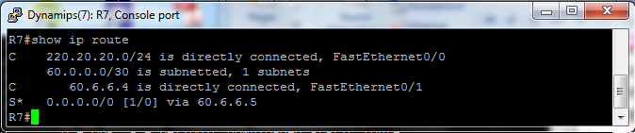
REDISTRIBUCIÓN ESTÁTICA
200.2.2.0/24
R1
R2
Habilitado con RIPv2
50.5.5.0/30
.9
PC1
.2
.1
.1
.2
50.5.8.0/30
60.6.6.0/30
210.10.10.0/24
.10
.1
.2
.1
.2
PC2
.13
50.5.12.0/30
R5
R6
PC3
.2
.1
.5
.6
.5
Enrutamiento
estático
.14
200.2.3.0/24
R3
50.5.5.4/30
R4
60.6.6.4/30
.6
R7
.1
.2
PC4
►Verifiquemos que esté
deshabilitado la propagación de
ruta por defecto en el router R5.
no default-information originate
220.20.20.0/24
No tiene RIP
►Todos los router tienen: no- auto-summary
Tabla en R7

Slide 29
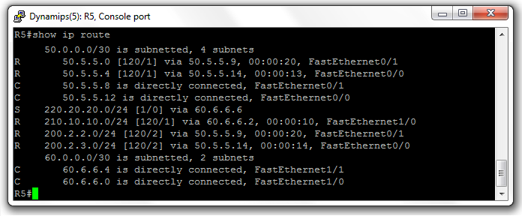
REDISTRIBUCIÓN ESTÁTICA
200.2.2.0/24
R1
R2
Habilitado con RIPv2
50.5.5.0/30
.9
PC1
.2
.1
.1
.2
50.5.8.0/30
60.6.6.0/30
210.10.10.0/24
.10
.1
.2
.1
.2
PC2
.13
50.5.12.0/30
R5
R6
PC3
.2
.1
.5
.6
.5
Enrutamiento
estático
.14
200.2.3.0/24
R3
50.5.5.4/30
R4
60.6.6.4/30
.6
R7
.1
.2
PC4
Tabla en R5
220.20.20.0/24
Cómo propagar
220.20.20.0 a la red
usando RIP ?

Slide 30
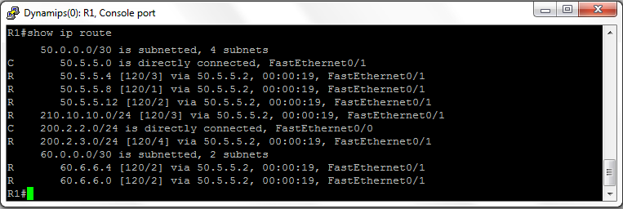
REDISTRIBUCIÓN ESTÁTICA
200.2.2.0/24
R1
R2
Habilitado con RIPv2
50.5.5.0/30
.9
PC1
.2
.1
.1
.2
50.5.8.0/30
60.6.6.0/30
210.10.10.0/24
.10
.1
.2
.1
.2
PC2
.13
50.5.12.0/30
R5
R6
PC3
.2
.1
.5
.6
.5
Enrutamiento
estático
.14
200.2.3.0/24
R3
50.5.5.4/30
R4
60.6.6.4/30
.6
R7
.1
.2
PC4
220.20.20.0/24
Tabla en R1
No sabe
como llegar a
220.20.20.0
R5 debe anunciar el link
estático 220.20.20.0

Slide 31
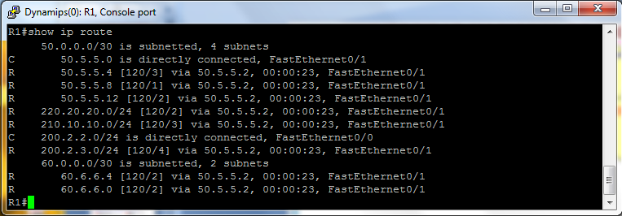
REDISTRIBUCIÓN ESTÁTICA
200.2.2.0/24
R1
R2
Habilitado con RIPv2
50.5.5.0/30
.9
PC1
.2
.1
.1
.2
50.5.8.0/30
60.6.6.0/30
210.10.10.0/24
.10
.1
.2
.1
.2
PC2
.13
50.5.12.0/30
R5
R6
PC3
.2
.1
.5
.6
.5
Enrutamiento
estático
.14
200.2.3.0/24
R3
50.5.5.4/30
R4
60.6.6.4/30
.6
R5(config)#router rip
R5(config-router)#redistribute static
R7
.1
.2
PC4
220.20.20.0/24
Se propaga
el prefijo de red
200.20.20.0

Slide 32
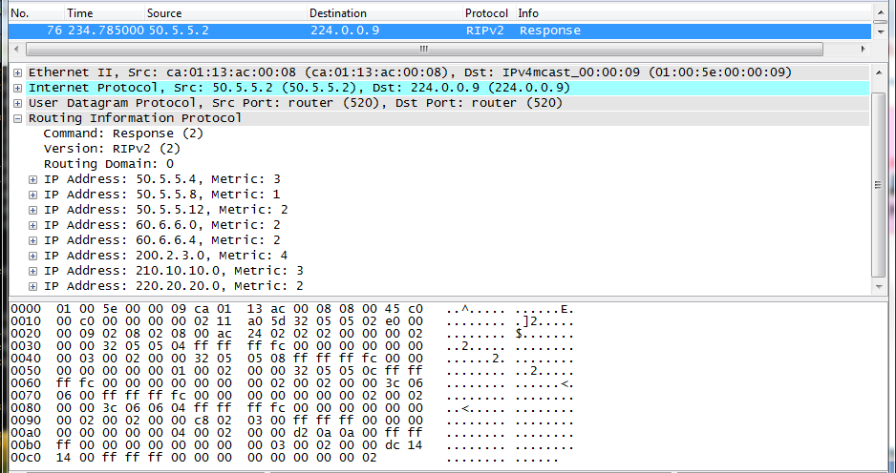
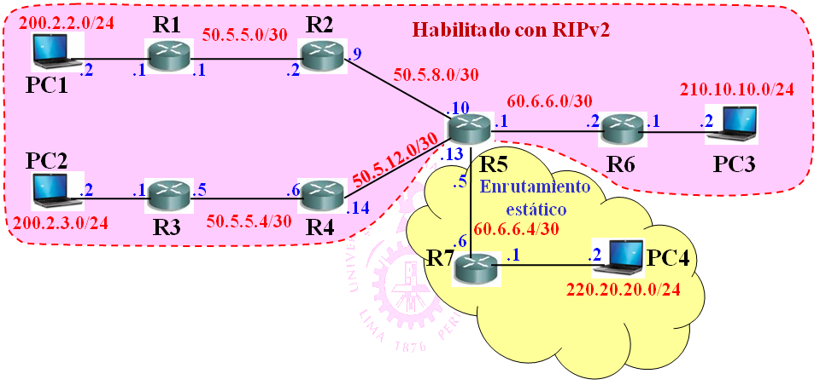
REDISTRIBUCIÓN ESTÁTICA
Redistribución
estática
R2 a R1

Slide 33
QUE SUCEDE EN LOS ROUTER CISCO?
CISCO implementa RIPv2 soportando:
►Autenticación
►Gestión de clave
►Summarization de rutas
►CIDR
►VLSM
De manera predeterminada, un router que
soporta RIPv2 no recibe paquetes RIPv1
CISCO ofrece comandos para RIPv1 y RIPv2
►version 1 → recibe y envía paquetes RIPv1
►version 2 → recibe y envía paquetes RIPv2

Slide 34
COMANDOS SEND Y RECEIVE
CISCO ofrece comandos para RIPv1 y RIPv2
►ip rip send version 1 → Configura una interfaz para
enviar sólo paquetes RIPv1
►ip rip send version 2 → Configura una interfaz para
enviar sólo paquetes RIPv2
►ip rip send version 1 2 → Configura una interfaz
para enviar ambos paquetes RIPv1 y RIPv2
►ip rip receive version 1 → Configura una interfaz
para recibir sólo paquetes RIPv1
►ip rip receive version 2 → Configura una interfaz
para recibir sólo paquetes RIPv2
►ip rip receive version 1 2 →

Slide 35
CUENTA A INFINITO
R3 detecta que la red
está desconectada, pero
se demora en envíar
mensaje a R2.
Actualización
30.3.3.0 salto=3
Actualización
Actualización
Actualización
30.3.3.0 salto=1
30.3.3.0 salto=2
20.2.2.0/24
30.3.3.0 salto=3
30.3.3.0/24
R1
40.4.4.0/30
R2
40.4.4.4/30
R3
.1
.2
.5
.6
.1
.1
Red Interfaz Salto
20.2.2.0 Directo 0
40.4.4.0 Directo 0
40.4.4.4 40.4.4.2 1
30.3.3.0 40.4.4.2 2
Red Interfaz Salto
40.4.4.0 Directo 0
40.4.4.4 Directo 0
20.2.2.0 40.4.4.1 1
30.3.3.0 40.4.4.6 1
Red Interfaz Salto
30.3.3.0 Directo 0
40.4.4.4 Directo 0
40.4.4.0 40.4.4.5 1
20.2.2.0 40.4.4.5 2
Red Interfaz Salto
20.2.2.0 Directo 0
40.4.4.0 Directo 0
40.4.4.4 40.4.4.2 1
30.3.3.0 40.4.4.2 4
Red Interfaz Salto
40.4.4.0 Directo 0
40.4.4.4 Directo 0
20.2.2.0 40.4.4.1 1
30.3.3.0 40.4.4.6 3
Red Interfaz Salto
30.3.3.0 40.4.4.5 2
40.4.4.4 Directo 0
40.4.4.0 40.4.4.5 1
20.2.2.0 40.4.4.5 2
Red Interfaz Salto
30.3.3.0 40.1.1.5 4
40.4.4.4 Directo 0
40.4.4.0 40.4.4.5 1
20.2.2.0 40.4.4.5 2
►Valor de métrica iría hasta el infinito.
►Para evitar llegar al infinito, se tiene que definir el valor
máximo de cuenta. Este valor es el 16.
CCNA 4.4.1

Slide 36
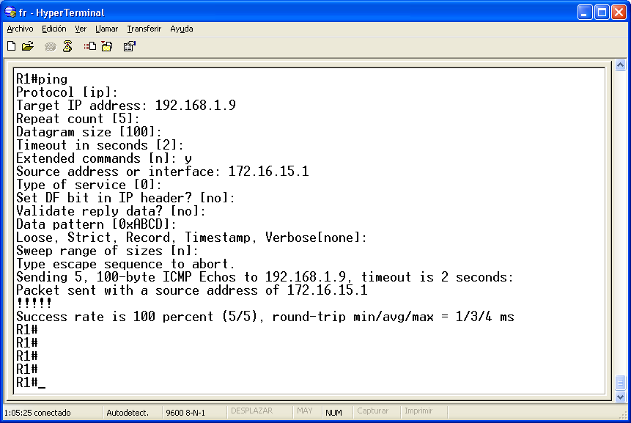
PING EXTENDIDO:
Lo_0 de router R1 a Lo_5 de router R6

Slide 37
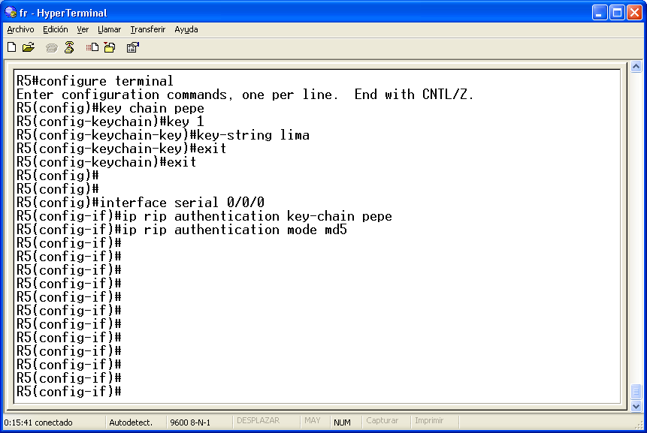
CONFIGURAR AUTENTICACION EN RIPv2

Slide 38
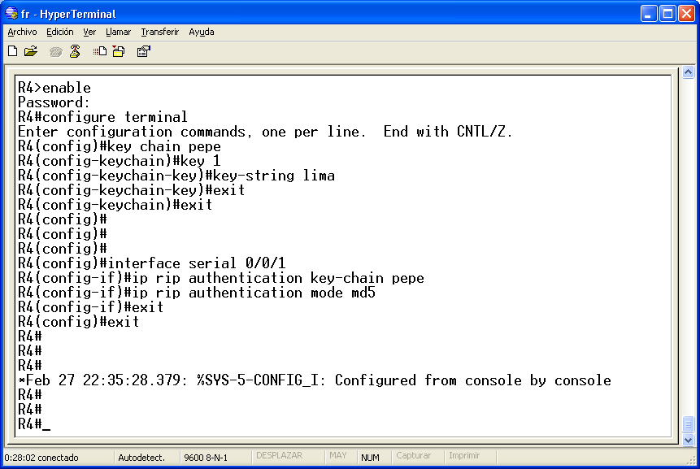
CONFIGURAR AUTENTICACION EN RIPv2
Como está la tabla de
enrutamiento en R5 ?
Que pasa si se introduce
key-string inictel

Slide 39
INTRODUCCIÓN AL
PROTOCOLO
OSPFv2

Slide 40
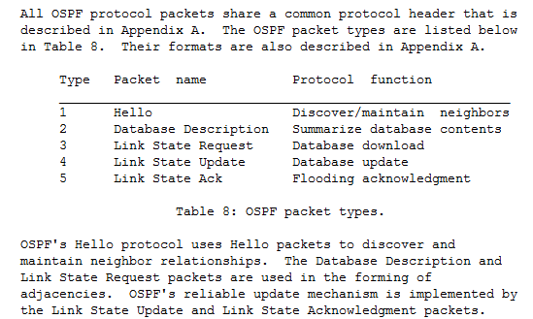
ASPECTO BÁSICO DEL PROTOCOLO OSPF
Definido por la
IETF en la RFC
2328, de Abril-98.
► Se encapsula en IP
con protocolo=59h.
► Se define 05 tipos
de mensajes.
► Lectura obligada.
Características más importante:
► Velocidad de convergencia.
► Mejor uso del ancho de
banda.
► Soporte de VLSM.
► Grandes redes IP: Áreas
► Se define “costos”.

Slide 41
CARACTERÍSTICAS DEL PROTOCOLO OSPF
Los routers vecinos deben conocerse entre si.
►Se hace uso del protocolo HELLO.
►Se envía periódicamente a la
dirección multicast IP 224.0.0.5
HELLO
Dirección IP 224.0.0.5
La clave de OSPF es el intercambio de estados.
Router
Crea una base
de datos
topológicas
El estado de enlace es la descripción
de una interfaz y de su relación con los
routers vecinos: dirección IP, máscara
de subred, tipo de red conectada, etc.
Llamado también
Base de datos de
Estado de Enlace
OSPF origina que cada routers conozca de manera
completa toda la red de su área.

Slide 42
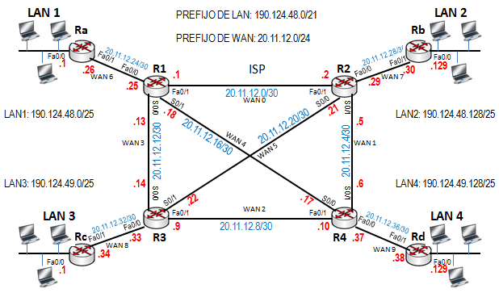
REDES DE ÁREA ÚNICA
SISTEMA AUTÓNOMO
AREA 0

Slide 43
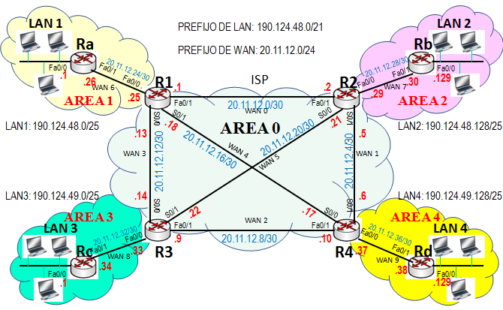
REDES MULTIAREAS
SISTEMA AUTÓNOMO

Slide 44
OBSERVACIONES AL ESTADO DE ENLACE
Los routers con estado de enlace requieren más
memoria y potencia de procesamiento, que un
router con vector-distancia.
Al inicio del proceso se debe inundar la red con
mensaje LSA, puede degradar la red.
Para reducir la base de datos topológica es
necesario dividir la red en áreas.
► El Área 0 es denominada también Área Backbone y en ella se
conectan las demás áreas.

Slide 45
CONFIGURACION DE
OSPFv2

Slide 46
ASPECTOS DE CONFIGURACIÓN (1/7)
Configuración OSPF:
Router# configure terminal
Router(config)# router ospf process-ID
Router(config-router)# network dirección_de_red wildcard
area area_ID
Router(config-router)# exit
Router(config)#
R1# configure terminal
R1(config)# router ospf 1
R1(config-router)# network 10.2.3.4 0.0.0.3 area 1
R1(config-router)# network 20.1.71.8 0.0.0.3 area 2
R1(config-router)# network 40.1.0.4 0.0.0.3 area 0
R1(config-router)# network 40.1.0.8 0.0.0.3 area 0
R1(config)#
Área 0
40.1.0.4/30
40.1.0.8/30
R1
Área 1
Área 2
10.2.3.4/30
20.1.71.8/30

Slide 47
ASPECTOS DE CONFIGURACIÓN (2/7)
Definición de Identificador de Router (ID-Router):
► Al iniciarse el proceso OSPF en un router, el IOS utiliza
la dirección IP activa local más alta como ID del router.
► Si no existe una interfaz activa, el proceso OSPF no se
iniciará.
► Para asegurar la estabilidad del proceso OSPF, es necesario
que el router tenga una interfaz activa en todo momento.
► La interfaz loopback es importante para este objetivo.
En un router con más de una interfaz loopback,
la dirección más alta será el ID-Router.
Selección del Router Designado (DR):
► La interfaz con mayor prioridad permitira el router sea DR.
► Ante iguales prioridades se selecciona el de mayor ID-Router.

Slide 48
ASPECTOS DE CONFIGURACIÓN (3/7)
Configuración de prioridad en una interfaz:
Router(config)# interface serial 0/0/0
Router(config-if)# ip priority número_de_prioridad
Un valor de prioridad puede variar de 0 a 255.
Valor 0 de prioridad imposibilita al router que
sea elegido DR.
En resumen sobre selección de DR y BDR:
► Mayor prioridad → Router DR.
► Segundo valor de prioridad → Router BDR.
► Routers con igual prioridad → Será DR el mayor ID-Router

Slide 49


ANÁLISIS DE LA RED MULTIAREA
R5
AREA 1
.2
.5
AREA 2
20.1.1.0/30
20.1.1.4/30
R6
R3
Costo 6
Costo 4
PCa
R1
30.3.3.0/30
.1
AREA 0
.6
R8
PCc
.65
.2
.9
40.4.4.0/30
.65
.1
.2
Costo 5
.17
.22
.1
.9
Costo 1
Costo 1
210.1.1.64/26
20.1.1.8/30
.9
220.2.2.64/26
Costo 2
Costo 7
20.1.1.16/30
20.1.1.20/30
Costo 1
.10
.21
30.3.3.8/30
.18
Costo 1
Costo 10
40.4.4.8/30
.14
20.1.1.12/30
.13
30.3.3.4/30
Costo 3
40.4.4.4/30
210.1.1.128/26
.10
.6
.6
.10
220.2.2.0/26
.129
R4
R7
Costo 1
.1
.5
.5
PCb
R2
R9
PCd

Slide 50
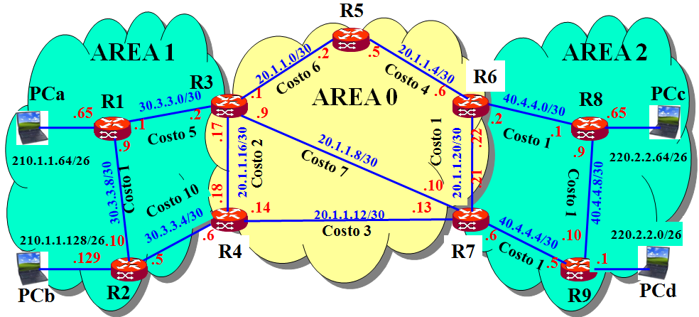
CONFIGURACIÓN DE ROUTER CON OSPF
R2>enable
R2#configute terminal
R2(config)#router ospf 1
R2(config-router)#network 30.3.3.4 0.0.0.3 area 1
R2(config-router)#network 30.3.3.8 0.0.0.3 area 1
R2(config-router)#network 210.1.1.128 0.0.0.63 area 1
R2(config-router)#exit
R1>enable
R1#configute terminal
R1(config)#router ospf 1
R1(config-router)#network 30.3.3.0 0.0.0.3 area 1
R1(config-router)#network 30.3.3.8 0.0.0.3 area 1
R1(config-router)#network 210.1.1.64 0.0.0.63 area 1
R1(config-router)#exit

Slide 51
CONFIGURACIÓN DE ROUTER CON OSPF
R7>enable
R7#configute terminal
R7(config)#router ospf 1
R7(config-router)#network 20.1.1.8 0.0.0.3 area 0
R7(config-router)#network 20.1.1.12 0.0.0.3 area 0
R7(config-router)#network 20.1.1.20 0.0.0.3 area 0
R7(config-router)#network 40.4.4.4 0.0.0.3 area 2
R7(config-router)#exit
R4>enable
R4#configute terminal
R4(config)#router ospf 1
R4(config-router)#network 20.1.1.12 0.0.0.3 area 0
R4(config-router)#network 20.1.1.16 0.0.0.3 area 0
R4(config-router)#network 30.3.3.4 0.0.0.3 area 1
R4(config-router)#exit
Los demás router se configuran de manera similar.

Slide 52
COSTOS OSPF POR DEFAULT
fa1/1
fa2/0
►Por default, OSPF asigna costo
asociado al ancho de banda:
R1>enable
R1#configute terminal
R1(config)#interface fastethernet 2/0
R1(config-if)#bandwidth 100 000
costo= 10⁸/(Ancho de banda)
Expresado en 1000
►Se puede usar el comando bandwidth
para cambiar el denominador de la fórmula

Slide 53
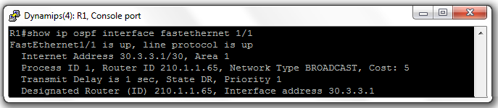
CONFIGURACIÓN DE COSTOS OSPF
fa1/1
fa2/0
R1>enable
R1#configute terminal
R1(config)#interface fastethernet 1/1
R1(config-if)#ip ospf cost 5
R1(config-router)#exit
R1(config)#interface fastethernet 2/0
R1(config-if)#ip ospf cost 1
R1(config-router)#exit
Los demás router se configuran de manera similar.
►Para observar el costo de una interfaz:
show ip ospf interface fastethernet 1/1

Slide 54
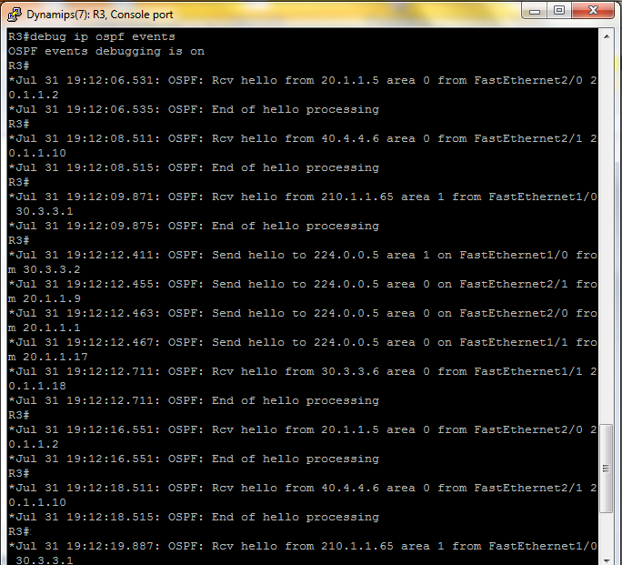
COMANDO debug ip ospf events
Se desactiva:
R#no debug ip ospf events

Slide 55
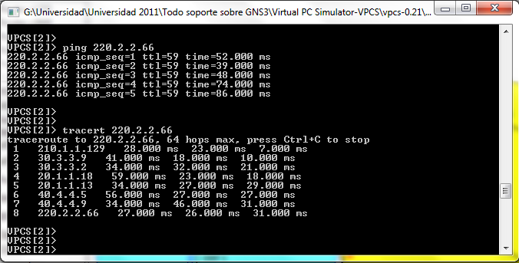
ANALISIS DE PATH PCb a PCc

Slide 56
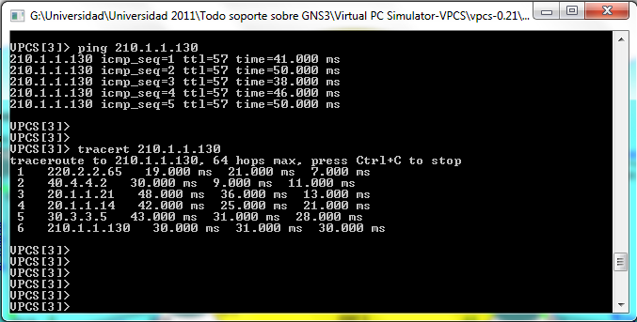
ANALISIS DE PATH PCc a PCb

Slide 57
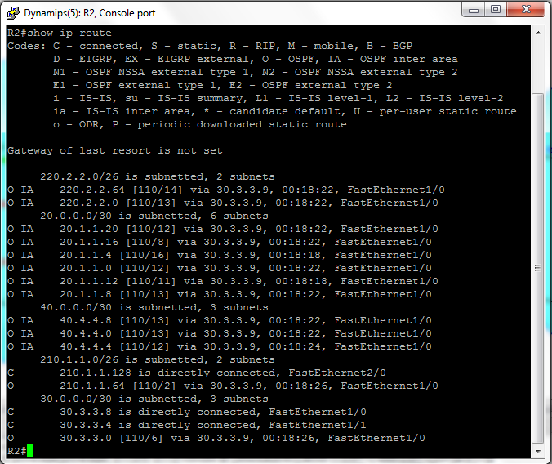
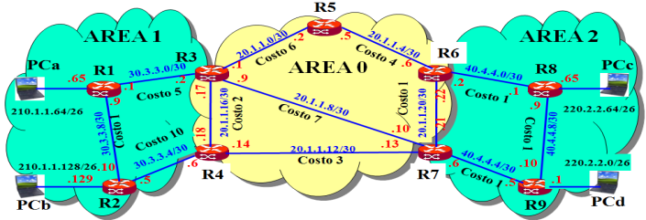
TABLA DE ENRUTAMIENTO DE R2
Costo total
► Costo total
desde R2 hasta
la red
220.2.2.64
es 14.

Slide 58
NUEVO ESCENARIO DE ANÁLISIS
Área 1
Lo_0: 131.4.5.33/28
Lo_1: 131.4.6.163/27
Lo_2: 190.1.7.73/29
Lo_3: 190.1.9.130/25
205.2.83.128/25
Lo_1
Lo_0
Fa0/0
10.2.2.36/30
R6
S0/0/0
Lo_3
Lo_10: 10.41.52.3/24
Lo_11: 10.41.68.19/24
Lo_12: 51.5.6.6/24
Lo_2
S0/0/1
Lo_13: 204.6.21.36/24
Lo_14: 204.9.80.94/24
Fa0/0
Fa0/1
Área 0
R1
Área 3
Lo_6
10.52.177.52/30
10.52.177.60/30
Lo_4
Lo_5
Lo_8
R2
Fa0/1
Fa0/0
R3
Lo_10
Lo_12
S0/0/1
10.52.177.56/30
S0/0/0
Lo_13
R4
Fa0/0
Fa0/1
R5
S0/0/0
Área 2
10.1.1.28/30
S0/0/1
10.1.1.24/30
Lo_7
Lo_9
Fa0/0
Lo_4: 210.7.2.31/24
Lo_5: 210.8.8.19/24
Lo_6: 55.0.4.3/17
Lo_7: 55.0.190.90//17
Lo_8: 140.1.160.3/21
Lo_9: 140.1.170.7/21
Fa0/0
Lo_11
Lo_14
200.4.5.0/24
210.7.9.0/24

Slide 59
OBTENCION DE ROUTER-ID
En el router R1
R1#show ip ospf
Routing Process "ospf 1" with ID 210.8.8.19
En el router R2
R2#show ip ospf
Routing Process "ospf 3" with ID 55.0.190.90
En el router R3
R3#show ip ospf
Routing Process "ospf 3" with ID 140.1.170.7

Slide 60
OBTENCION DE ROUTER-ID
En el router R4
R4#show ip ospf
Routing Process "ospf 1" with ID 10.41.68.19
En el router R5
R5#show ip ospf
Routing Process "ospf 3" with ID 204.9.80.94
En el router R6
R6#show ip ospf
Routing Process "ospf 3" with ID 131.4.6.163

Slide 61
USANDO show ip ospf neighbor
En el router R1
R1#show ip ospf neighbor
Neighbor ID Pri State Dead Time Address Interface
131.4.6.163 0 FULL/ - 00:00:33 10.2.2.37 Serial0/0/1
55.0.190.90 1 FULL/BDR 00:00:38 10.52.177.62 FastEthernet0/0
140.1.170.7 1 FULL/BDR 00:00:33 10.52.177.53 FastEthernet0/1
R1#
En el router R3
R3#show ip ospf neighbor
Neighbor ID Pri State Dead Time Address Interface
55.0.190.90 1 FULL/BDR 00:00:39 10.52.177.57 GigabitEthernet0/1
210.8.8.19 1 FULL/DR 00:00:34 10.52.177.54 GigabitEthernet0/0
204.9.80.94 0 FULL/ - 00:00:31 10.1.1.30 Serial0/0/0
R3#

Slide 62
ESTABLECIENDO ENLACE VIRTUAL
Área 1
Lo_0: 131.4.5.33/28
Lo_1: 131.4.6.163/27
Lo_2: 190.1.7.73/29
Lo_3: 190.1.9.130/25
205.2.83.128/25
Lo_1
Lo_0
Fa0/0
10.2.2.36/30
R6
virtual-link
S0/0/0
Lo_3
Lo_10: 10.41.52.3/24
Lo_11: 10.41.68.19/24
Lo_12: 51.5.6.6/24
Lo_2
virtual-link
Lo_13: 204.6.21.36/24
Lo_14: 204.9.80.94/24
S0/0/1
Fa0/0
Fa0/1
Área 0
R1
Área 3
Lo_6
10.52.177.52/30
10.52.177.60/30
Lo_4
Lo_5
Lo_8
R2
Fa0/1
Fa0/0
R3
Lo_10
Lo_12
S0/0/1
10.52.177.56/30
S0/0/0
Lo_13
R4
Fa0/0
Fa0/1
R5
S0/0/0
Área 2
10.1.1.28/30
S0/0/1
10.1.1.24/30
Lo_7
Lo_9
Fa0/0
Lo_4: 210.7.2.31/24
Lo_5: 210.8.8.19/24
Lo_6: 55.0.4.3/17
Lo_7: 55.0.190.90//17
Lo_8: 140.1.160.3/21
Lo_9: 140.1.170.7/21
Fa0/0
Lo_11
Lo_14
200.4.5.0/24
210.7.9.0/24

Slide 63
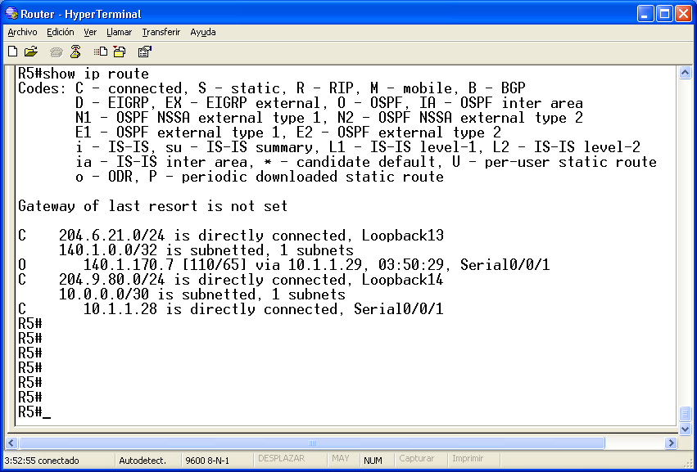
OBSERVANDO LA TABLA DE RUTEO EN R5
Observar que un loopback siempre se anuncia con una máscara 255.255.255.255

Slide 64
CONFIGURANDO VIRTUAL-LINK
virtual-link
Área 0
R1
Área 3
Lo_6
10.52.177.52/30
10.52.177.60/30
Lo_4
Lo_5
Lo_8
R2
Fa0/1
Fa0/0
R3
Lo_10
Lo_12
S0/0/1
10.52.177.56/30
S0/0/0
Lo_13
R4
Fa0/0
Fa0/1
R5
S0/0/0
Área 2
10.1.1.28/30
S0/0/1
10.1.1.24/30
Lo_7
Lo_9
Fa0/0
Lo_7: 55.0.190.90//17 Lo_9: 140.1.170.7/21
Fa0/0
Lo_11
Lo_14
200.4.5.0/24
210.7.9.0/24
R2>enable
R2#configure terminal.
R2(config)#router ospf 2
R2(config-router)#area 2 virtual-link 140.1.170.7
R2(config-router)#exit
R2(config)#
R3>enable
R3#configure terminal.
R3(config)#router ospf 3
R3(config-router)#area 2 virtual-link 55.0.190.90
R3(config-router)#exit
R3(config)#

Slide 65
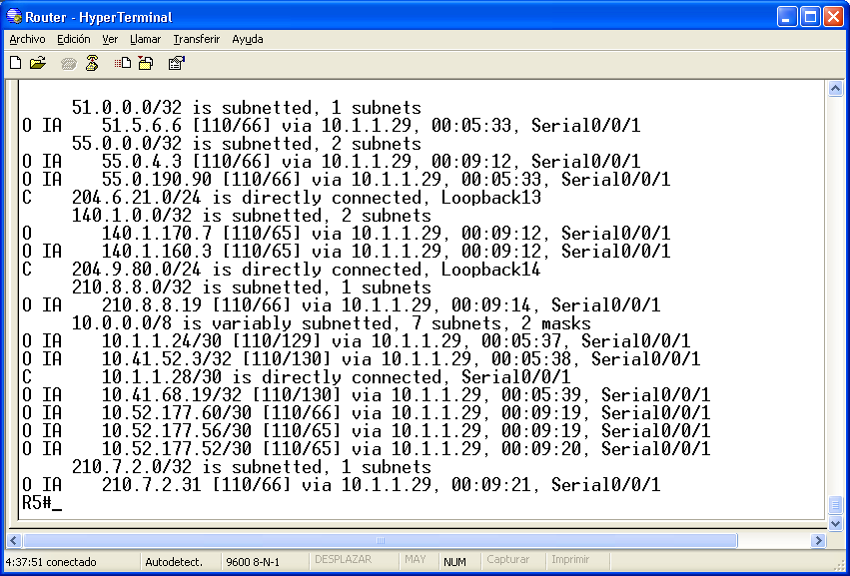
OBSERVANDO LA TABLA DE RUTEO EN R5

Slide 66
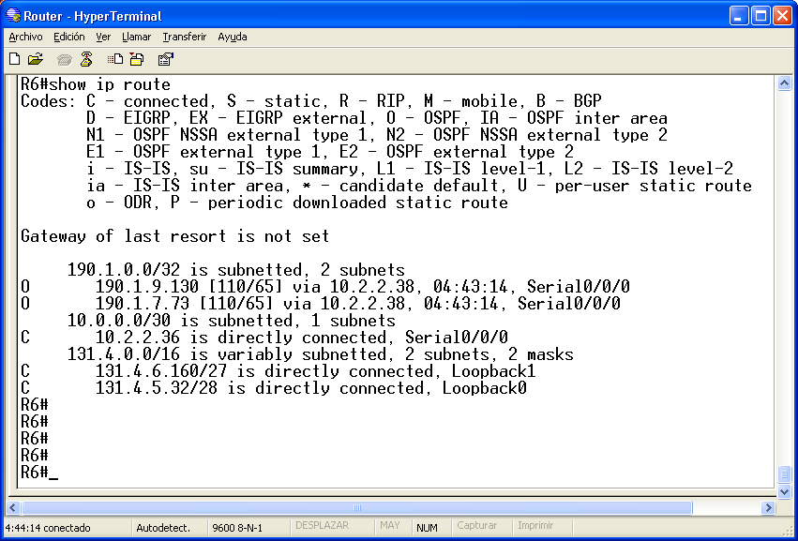
OBSERVANDO LA TABLA DE RUTEO EN R6

Slide 67
CONFIGURANDO VIRTUAL-LINK
Área 1
205.2.83.128/25
Lo_1
Lo_0
Fa0/0
10.2.2.36/30
R6
S0/0/0
Lo_3
Lo_2
S0/0/1
virtual-link
R1>enable
R1#configure terminal
R1(config)#router ospf 1
R1(config-router)#area 2 virtual-link 55.0.190.90
R1(config-router)#exit
R1(config)#
Fa0/0
Fa0/1
Área 0
R1
Lo_6
10.52.177.52/30
10.52.177.60/30
Lo_4
Lo_5
Lo_8
R2
Fa0/1
Fa0/0
Lo_10
Lo_12
S0/0/1
10.52.177.56/30
R4
Fa0/0
Fa0/1
S0/0/0
Área 2
10.1.1.24/30
R2>enable
R2#configure terminal
R2(config)#router ospf 2
R2(config-router)#area 2 virtual-link 210.8.8.19
R2(config-router)#exit
R2(config)#
Lo_7
Fa0/0
Lo_11
Lo_5: 210.8.8.19/24
Lo_7: 55.0.190.90//17
200.4.5.0/24

Slide 68
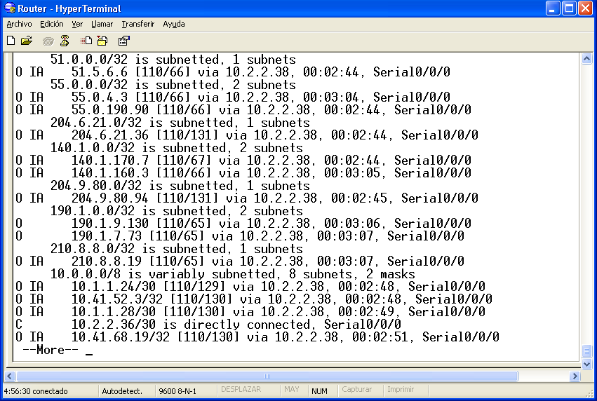
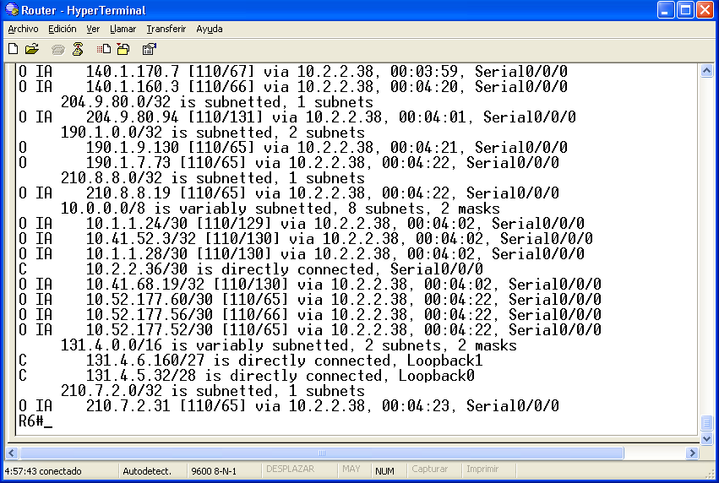
OBSERVANDO LA TABLA DE RUTEO EN R6

Slide 69
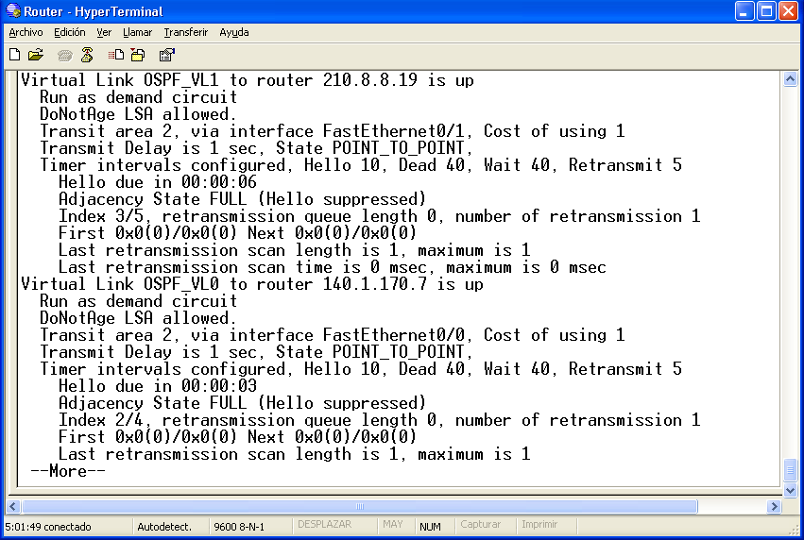
ANALIZANDO LOS VIRTUAL-LINK
R2#show ip ospf virtual-link

Slide 70
CONFIGURACION DE
RIPv2-OSPF

Slide 71
ANÁLISIS DE UNA RED OSPF/RIP
R5
RIPv2
AREA 1
.2
.5
AREA 2
20.1.1.0/30
20.1.1.4/30
RIPv2
R3
Costo 6
Costo 4
R6
PCa
R1
30.3.3.0/30
.1
AREA 0
.6
R8
PCc
.65
.2
.9
40.4.4.0/30
.65
.1
.2
Costo 5
.17
.22
.1
.9
Costo 1
Costo 1
210.1.1.64/26
20.1.1.8/30
.9
220.2.2.64/26
Costo 2
Costo 7
20.1.1.16/30
20.1.1.20/30
Costo 1
.10
.21
30.3.3.8/30
.18
Costo 1
Costo 10
40.4.4.8/30
.14
20.1.1.12/30
.13
30.3.3.4/30
Costo 3
40.4.4.4/30
220.2.2.0/26
210.1.1.128/26
.10
.6
.6
.10
.129
R4
R7
Costo 1
.1
.5
.5
PCb
R9
PCd
R2
RIPv2
RIPv2
OSPFv2
Revisión de redistribución RIP y OSPF en:
http://docwiki.cisco.com/wiki/Internetwork_Design_Guide_--_RIP_and_OSPF_Redistribution#RIP_and_OSPF_Redistribution

Slide 72
ANÁLISIS DE UNA RED OSPF/RIP
router ospf 1
redistribute rip subnets
network 30.3.3.0 0.0.0.3 area 1
network 30.3.3.8 0.0.0.3 area 1
router rip
version 2
redistribute ospf 1 match internal external 1 external 2
network 210.1.1.64
no auto-summary
R5
RIPv2
AREA 1
.2
.5
AREA 2
20.1.1.0/30
20.1.1.4/30
RIPv2
R3
Costo 6
Costo 4
R6
PCa
R1
30.3.3.0/30
.1
AREA 0
.6
R8
PCc
.65
.2
.9
40.4.4.0/30
.65
.1
.2
Costo 5
.17
.22
.1
.9
Costo 1
Costo 1
210.1.1.64/26
20.1.1.8/30
.9
220.2.2.64/26
Costo 2
Costo 7
20.1.1.16/30
20.1.1.20/30
Costo 1
.10
.21
30.3.3.8/30
.18
Costo 1
Costo 10
40.4.4.8/30
.14
20.1.1.12/30
.13
30.3.3.4/30
Costo 3
40.4.4.4/30
220.2.2.0/26
210.1.1.128/26
.10
.6
.6
.10
.129
R4
R7
Costo 1
.1
.5
.5
router ospf 1
redistribute rip subnets
network 30.3.3.4 0.0.0.3 area 1
network 30.3.3.8 0.0.0.3 area 1
router rip
version 2
redistribute ospf 1 match internal external 1 external 2
network 210.1.1.128
no auto-summary
PCd
PCb
R2
R9
RIPv2
RIPv2
OSPFv2

Slide 73
ANÁLISIS DE UNA RED OSPF/RIP
172.16. 0.0/16
RIPv2
.0.2
BW 100Mbps
.0.1
Ra
.198
.201
S1
S0
OSPFv2
AREA 0
10.0.37.196/30
10.0.37.200/30
BW 1544kbps
S0
.197
.202
S1
S1
S0
.206
.65
10.0.37.204/30
.205
.129
router ospf 1
redistribute rip subnets
network 10.0.37.196 0.0.0.3 area 0
network 10.0.37.200 0.0.0.3 area 0
router rip
version 2
redistribute ospf 1 match internal external 1 external 2
network 172.16.0.0
no auto-summary
BW 100Mbps
BW 100Mbps
.66
.130
RIPv2
RIPv2
200.37.42.0/24
200.37.51.0/24

Slide 74
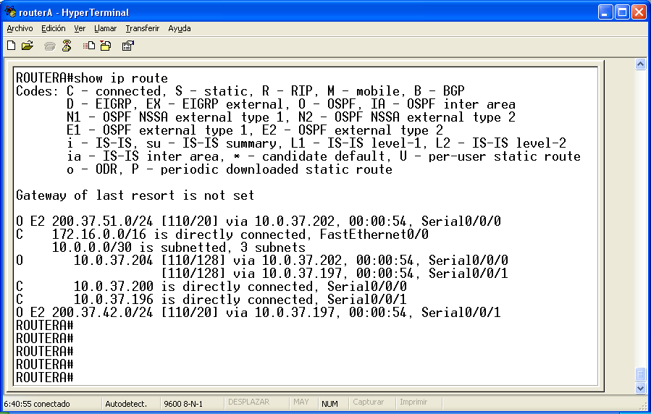
TABLA DE ENRUTAMIENTO

Slide 75
PROPUESTAS DE TEMAS DE EXPOSICION
Network Simulator
The Network Simulator, ns-2
http://www.isi.edu/nsnam/ns/tutorial/
NS by Example
http://nile.wpi.edu/NS/
OPNET IT GURU
http://www.opnet.com/university_program/itguru_academic_edition/

Slide 76
BIBLIOGRAFIA
RFC 2453 RIP version 2
Noviembre de 1998.
http://www.ietf.org/rfc/rfc1058.txt
Routing Information Protocol, Autor CISCO
http://www.cisco.com/univercd/cc/td/doc/cisintwk/ito_doc/rip.pdf

Slide 77
BIBLIOGRAFIA
RFC 1058 Routing Information Protocol
Junio de 1988.
http://www.ietf.org/rfc/rfc1058.txt
RFC 1723 RIP version 2, Noviembre de 1994
http://www.ietf.org/rfc/rfc1723.txt
RFC 2082 MD5 Authentication
http://www.ietf.org/rfc/rfc2082.txt
Routing Information Protocol, Autor CISCO
http://www.cisco.com/univercd/cc/td/doc/cisintwk/ito_doc/rip.pdf

Slide 78
MUCHAS GRACIAS

